Slide 1

SLIDE 1
Team Name: Techno
2. Members Name and Phone Numbers:
Akshara Ganeshram(leader): 8072984663; 3rd year
Gauri Joshi: 9559204188; 3rd year
Sanskriti Binani: 9772124202; 3rd year
Vinayak Sharma: 9962744519; 3rd year
3. Domain name: Voice and Image Processing
4. Problem statement: Convert the blueprint of an architectural structure into a 3-D compatible navigation system API

Slide 2
SLIDE 2
ABSTRACT
Ever felt the need of maps or a some navigation system inside of a building? Here is our project that fulfills your navigation and guidance needs inside of buildings and monuments, with an easy to use, interactive and intuitive User Interface.

Slide 3
SLIDE 3
NOVELTY
Google Maps for the insides of the building but it is even more interactive and an intuitive UI
Highly customisable indoor navigation system right in the palm of your hand which will never let you get lost again in the big corporate buildings and hospitals.
The project can be scaled to act like a virtual tour guide.

Slide 4
SLIDE 4
TECHNOLOGY STACK
Unity
Native Android Dev
Augmented Reality / GPS

Slide 5
SLIDE 5
METHODOLOGY
Basically we make a blueprint of the building in unity.
Then we use 3D mapping to map the blueprint to the actual space so that the model in unity scales and orients correctly with respect to actual objects.
Then we use a QR code or a distinct sign to orient the user in the 3D space correctly.
Then we use navigation mesh to guide the user to the destination.
SLIDE 4

Slide 6
SLIDE 6
HARDWARE / SOFTWARE IMPLEMENTATION
Unity – 3D model creation The 3-D model of the building shall be implemented using Unity which will be further used in path finding inside the building model.
Native Android Dev – UI of the implementation through a App Run an instance of our unity project in native. Obtain information like starting point and destination from the user using the application interface to integrate with unity.
If possible we use AR to get the above stated details else we use GPS and compass to guide.

Slide 7
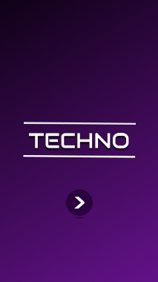
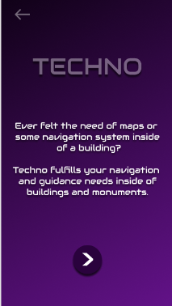
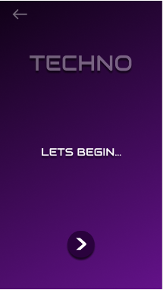
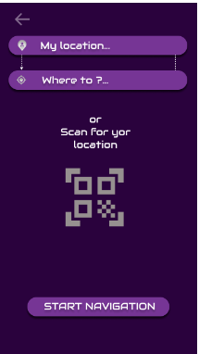
SLIDE 7
UI OF OUR APP

Slide 8
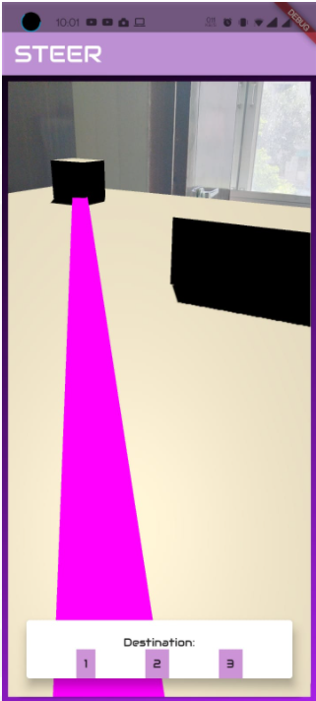
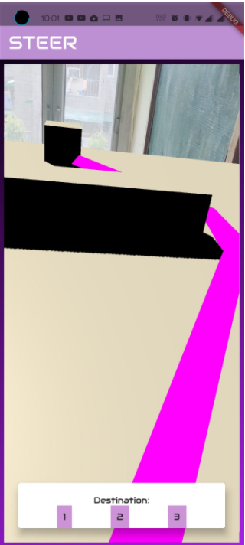
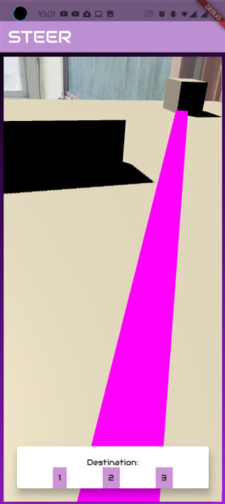
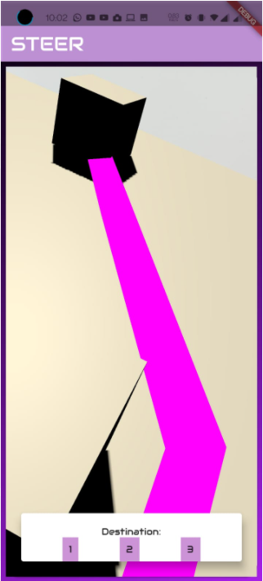
SLIDE 8
RESULTS

Slide 9
SLIDE 9
BUSINESS SCOPE
The project finds its scope in all the places where one generally feels that, their task could have been easier if there was a map to guide them inside a huge building like the modern day corporate offices, hospitals, schools, monuments etc. Inside of large buildings where people need to navigate from one place to another, like one office to another. All one needs to do is to scan a QR code that can be there at the entrance of the building and enter your current location and then feed your desired location in the app which will then will guide you through, just as wonderfully Google Maps would do, in the outside world.
It can also be used in the Tourism Industry and can be integrated with voice guided tours for all round experience.

Slide 10
Thank You!

